Slide 1
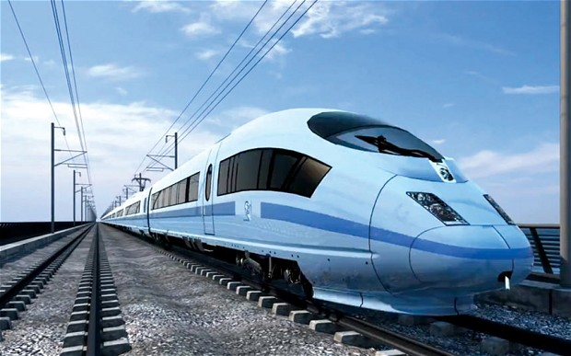
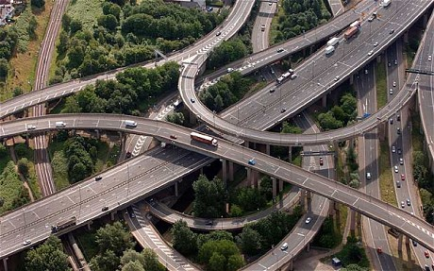



The Infrastructure Challenge:
How much, for whom, at what cost and when?
Dan Lewis (in personal capacity) – 8th September 2014, London.

Slide 2
Breakdown of talk:
  About me
  Defining & Scoping Infrastructure
  Some Guiding Principles
  The Infrastructure Challenge
  Infrastructure Finance
  Topical issues: Airports, Spaceports, Scotland, National Infrastructure Commission?

Slide 3




About Dan Lewis
Outreach & meetings a big part of the IoD’s work
Working part-time for IoD since 2011
Economic, Energy, Geospatial Data
Research & Media
Space Economy: UK Spaceplane Regulatory Workshop Committee
Energy Policy and Events

Slide 4
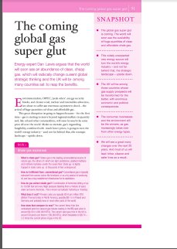

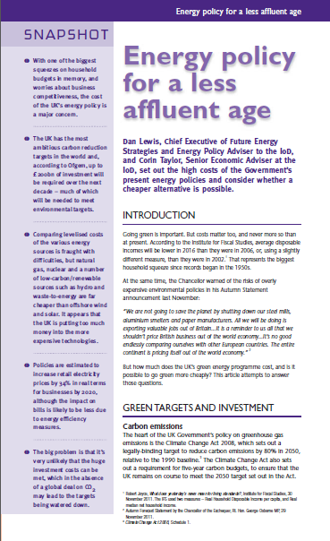
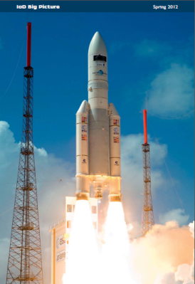






IoD Papers since 2011

Slide 5
Defining & Scoping Infrastructure
  Defining: 1) Social (Hospitals, Schools) & 2) UK National Infrastructure Plan: Roads, railways, Ports, Energy, Telecoms, Flood Defences, Waste, Intellectual Capital & Water (also local amenities & Airports)
  Spending? £45 bn in 2013 or £375 bn by 2020 (Questionable)
  Focus? £340 bn on Energy (215) & Transport (Value for Money?)
  Private Sector Delivery? 85%
  Who owns it? 60% Private Sector (Armitt Review)

Slide 6
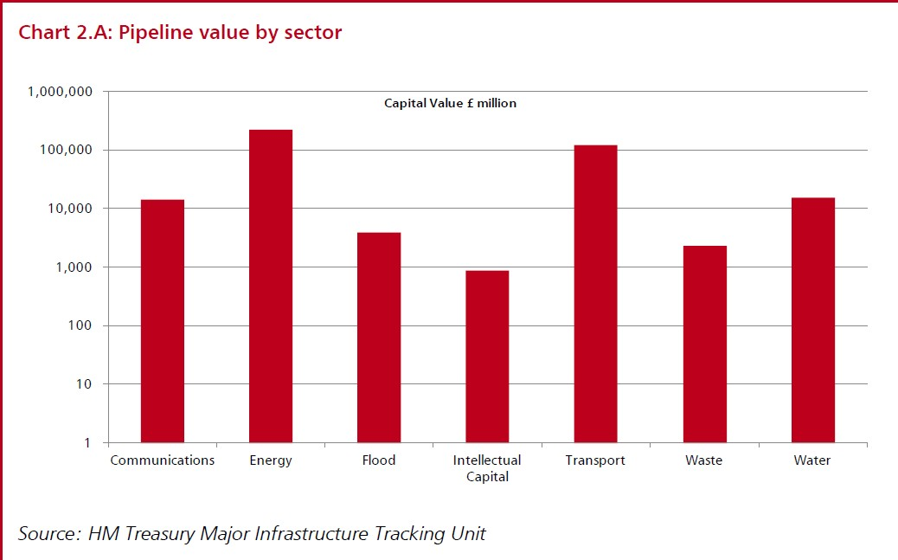
Infrastructure spend – N.B. logarithmic scale

Slide 7
UK Infrastructure “Challenges” # 1
  A poor world ranking: 28/144 versus 8/144 for economic competitiveness (WEF)
  Fast growing population: 70m by 2030
  Govt. stimuli – time lag 6-24 months, tendering, procurement, planning, EIAs
  Tracking opportunity costs – hard to measure silent & invisible victims
  Being realistic about the multiplier effect - buying, hiring, producing and unsustainable lumpy distribution of capital expenditure

Slide 8
UK Infrastructure “Challenges” # 2
  Future & whole life costs: too much emphasis on value added by construction – not enough on cost-generating post construction
  Planning: favours “No” - e.g. shale – risk capital in short supply
  Political risk – bigger the project, more politically vulnerable, raising cost of capital
  There is not enough money – £200 bn? Utilities are broke
  Consumers, Taxpayers & SWFs – far from willing to foot the costs – e.g. Offshore Wind, Hinkley C, Smart Meters & New Hub Airport Connectivity

Slide 9
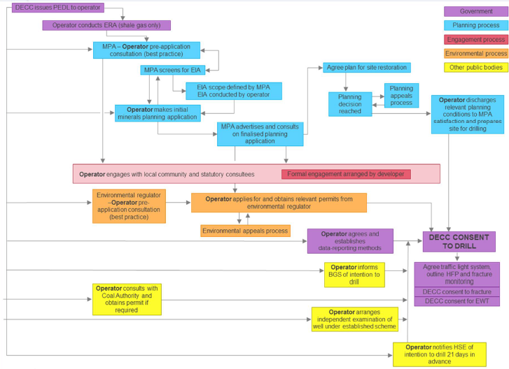

Shale: what’s the hold-up? Regulations

Slide 10
Infrastructure Policy Environment
  A wish list of construction, engineering and Blue Chip Consultancy Industries
  Mantra of spending is always good and adds value

Slide 11
Infrastructure Policy – A new Approach
  From spending driven to full spectrum CBA
  Speed up & reduce cost of planning
  A shift in management – public to private
  Increase private ownership
  Enhanced open data drive – e.g. data on roads, flood plains data

Slide 12
Infrastructure Policy – A new opportunity
  Capex smooth or lumpy?
  Create additional consumer choice?
  Crowd out existing infrastructure?
  Promote capital deepening?
  An additional asset?
  What are the on-costs?
  IoD Infrastructure Value Index in development

Slide 13

3 Publications in Prospect
  September: Infrastructure Financing
  TBC: Annual IoD Infrastructure Report
  October/November: Airports: Evolutionary Optimal Decision Time
  Later
  Broadband – faster, cheaper, how?
  Trains
  Housing?

Slide 14
Infrastructure Finance in prolonged period of Austerity
  PFI to PF2 – approx 8%
  Electricity Market Reform – 10-12%
  Regulated Asset Base – 3.8 – 4.9%
  30 Year Gilt Yield – 3.02%
  To watch: Network Rail debt piling up

Slide 15
Airports – South-East Expansion
  Review in progress of IoD policy
  Will not be bound by shortlist, SIFT criteria or timeframes of the Davies Commission
  Will ask different questions, model different scenarios
  And be conscious to cost of public purse, consumer choice, competition, and range of existing and future business models
  ITE – Piraeus Harbour of 21st Century with BoJo as Pericles?
  Or a “Megaproject” (Prof. Bent Flvbjerg) destined for repetition of Megaproject Iron Law?

Slide 16

Spaceports
  Submitted to Review – findings announced Farnborough
  Shortlist: Newquay, Llanbedr and 6 in Scotland
  Stornoway, Lossiemouth, Kinloss, Leuchars, Campbelltown, and Glasgow Prestwick

Slide 17
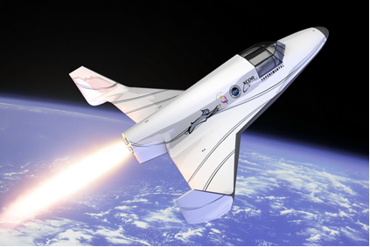



Vehicles in Prospect - UK
Later? Masten Space Systems, Armadillo Aerospace, Blue Origin
Not about who launches first
But who launches how often, from where and at what price

Slide 18

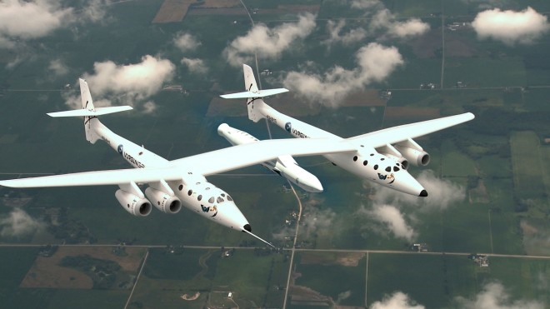

Small satellite launch from UK?
Air launched proposals
From 2020s possible
Research going into vertical launch from UK
< 500 kg
Requires different kind of spaceport

Slide 19



An Independent Scotland ?
  Major risk of stranded
  infrastructure assets
  Will rUK pay for Scotland’s
  Oil and subsidize their renewables and 100% 2020 target not possible without exports to England?
  Transmission upgrades on hold – size of Scottish domestic market and tax base not enough to meet the cost

Slide 20
An Independent Infrastructure Commission?
  Could create a tax-funded body that always argues for tax-funded infrastructure
  But clearly a need to develop a more systemic approach to infrastructure
  Which Olympic Delivery Authority did – albeit under unmoveable time constraint
Dan Lewis – 7th July 2014, 116 Pall Mall.

Slide 21
Thankyou
  Questions, ideas, critiques etc. – all welcome
  dan@future-es.com
  dan@economicpolicycentre.com
  dan.lewis@iod.com
  M. 07900 245 306
Dan Lewis – speaking in personal capacity

