Slide 2
Designing Tall Buildings: Why is it different? A pause for reflection and overview

Slide 3
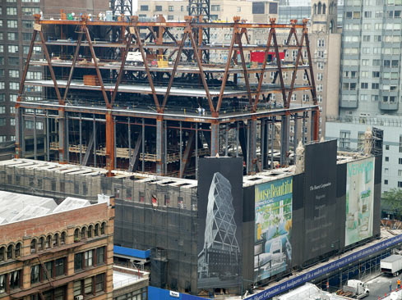
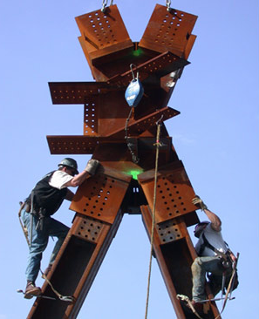
Engineering Challenges with Tall Buildings
Scale

Slide 4
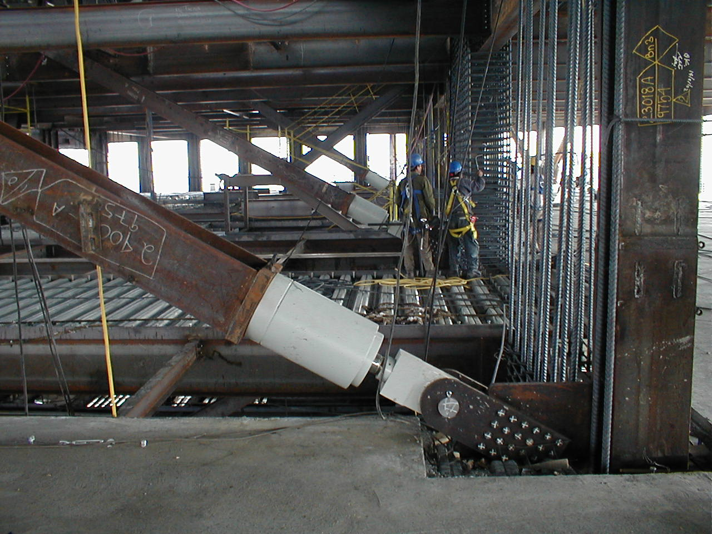
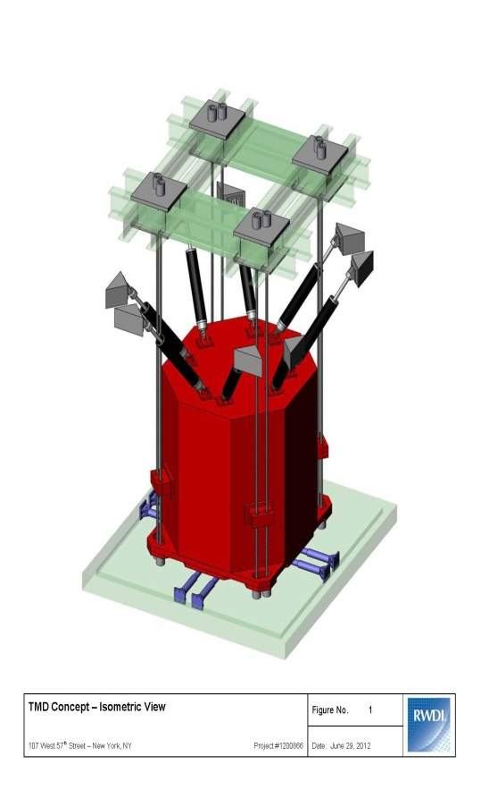
Engineering Challenges with Tall Buildings
Wind and other lateral loads

Slide 5
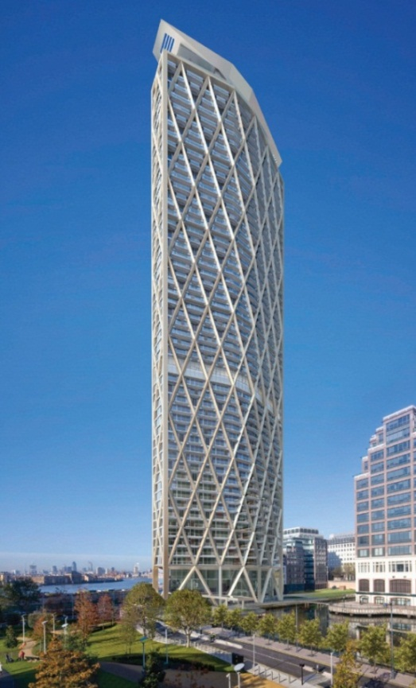
Engineering Challenges with Tall Buildings
Structural systems and possible impact on the building

Slide 6
Engineering Challenges with Tall Buildings
Axial Shortening
Foundations
Speed and complexity of construction
The sometimes difficult balance between science and unnecessary complexity
Confidence and over-confidence
Efficiency and net to gross

Slide 7
Trends and the Future for High-rise Design & Construction

Slide 8
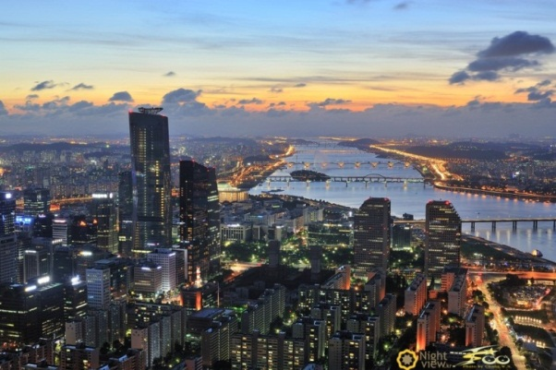
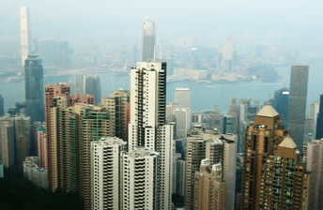
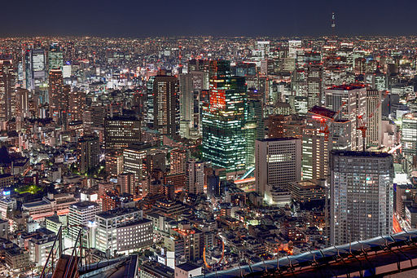
Lighter, cheaper and more net lettable
Making tall buildings more efficient
Global influences – learn from other high-rise nations
Join the Council on Tall Buildings and Urban Habitat

Slide 9
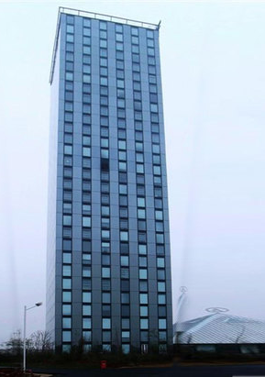
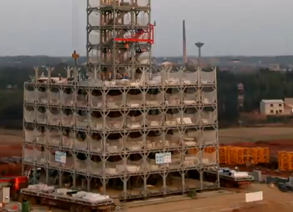
Prefabrication and modularisation

Slide 10
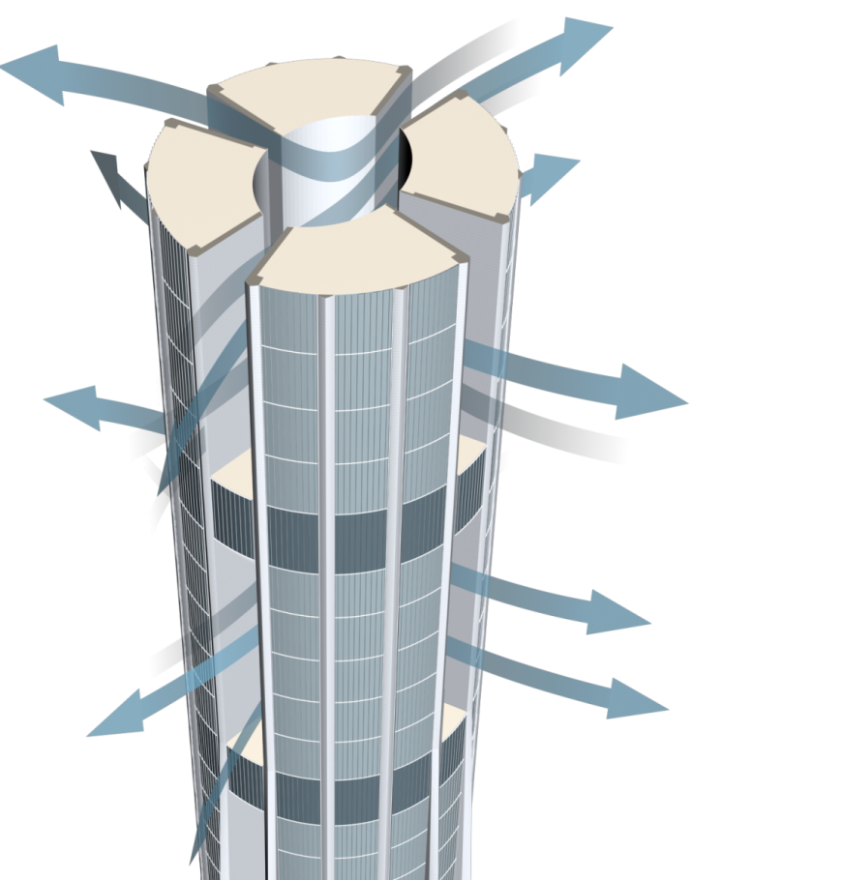
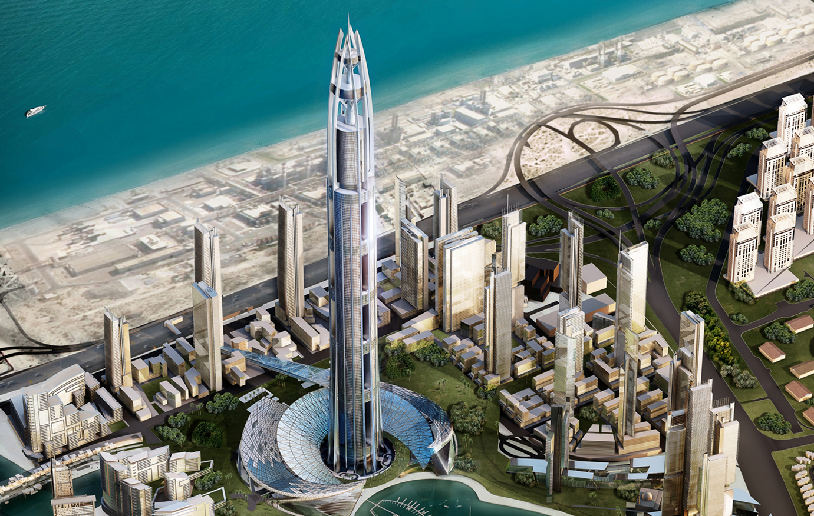
Extreme Engineering – Al Burj, Dubai

Slide 11
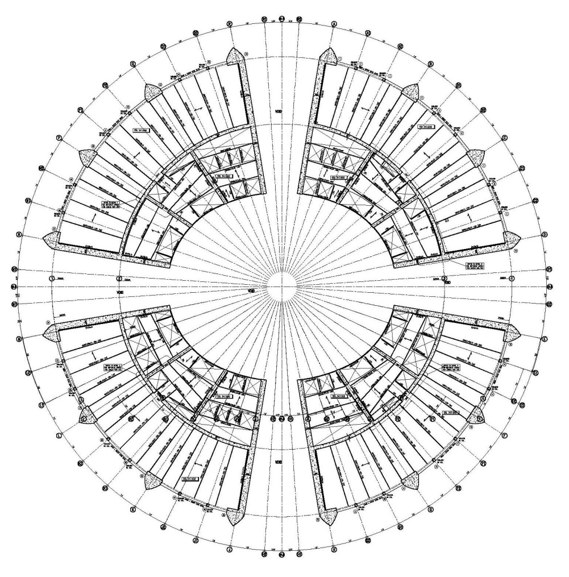
Al Burj, Dubai – Key Vertical Structural Elements
“Hammer” Mega-Column
Mega-Columns
Hammer Wall
Inner Drum Wall
Fin Wall

Slide 12
Al Burj, Dubai – Construction

Slide 13
Al Burj, Dubai – Concrete Considerations
40 MPa
Cylinder strengths up to 100 MPa
Stiffness
Workability
Pumpability
Stickiness
Sourcing
Heat
Durability
Reliability
50 MPa
60 MPa
70 MPa
80 MPa
90 MPa
100 MPa

Slide 14
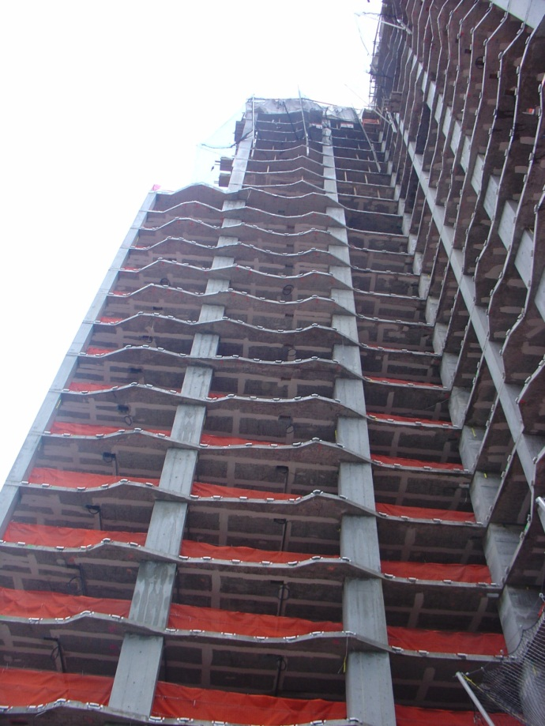
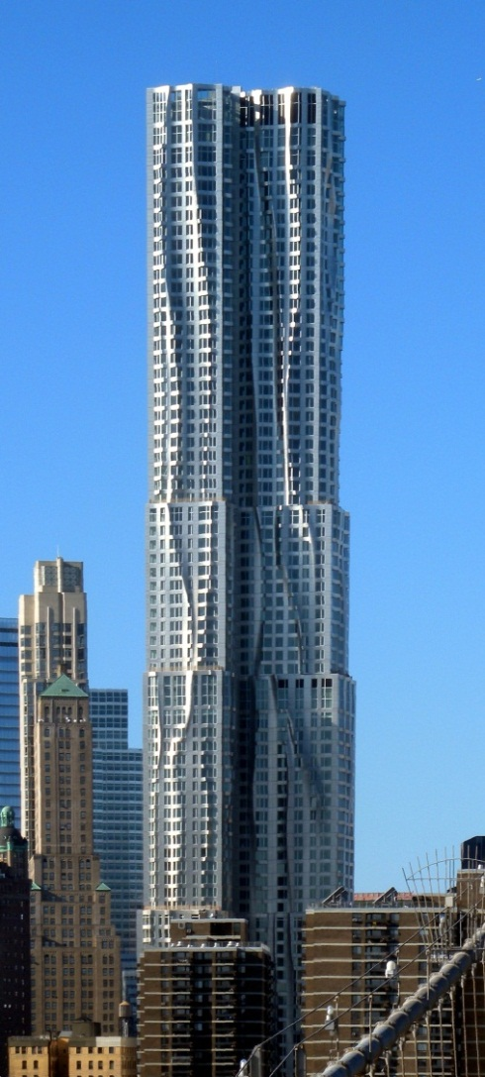
Extreme Engineering – Beekman Tower, NY

Slide 15
Extreme Engineering – 432 Park Avenue, NY
Building Height: 425 m
Slenderness: 1:15
Wind Drift: L/ 400
Governing Period: 13 sec.

Slide 16
Extreme Engineering
Braced Core – Shear Walls
Perimeter Moment Frame

Slide 17
Extreme Engineering
Outrigger System

Slide 18
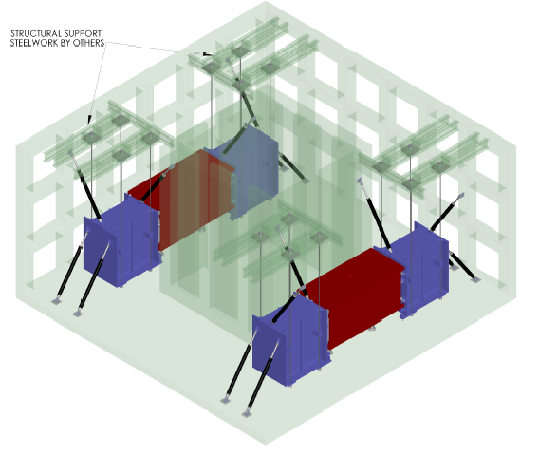
Extreme Engineering

Slide 19
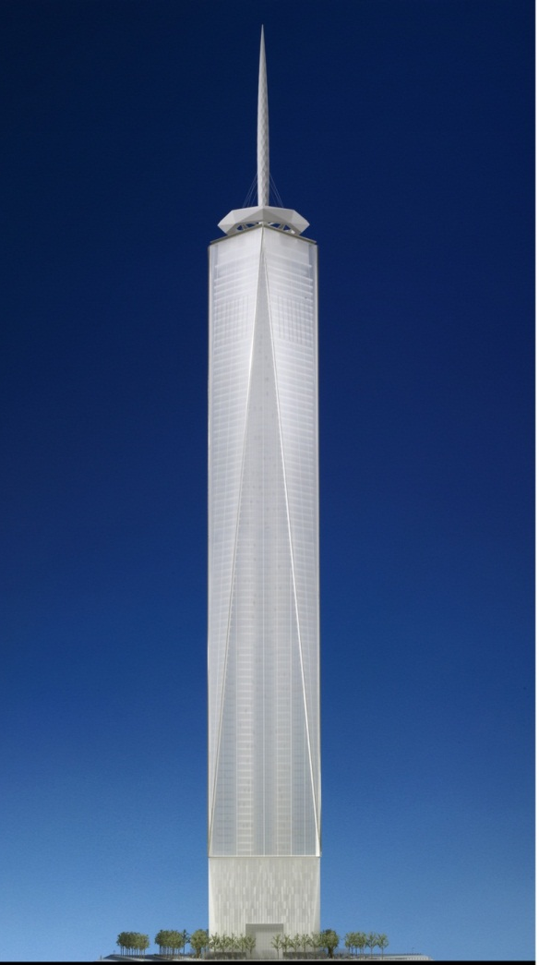
Extreme Engineering – One World Trade Center, NY
Ht. 1776’, (540M)
Antenna & Cable Structure
Ht. 1368’-0” (417 M)
MEP, Restaurant & Ob. Deck
Ht. 1107’-8”
Office Floors
Ht. 186’-8”
MEP
Ht. 66’-8”
Lobby
Ht. 0’-0”
Basement
Ht. -70’-0”

Slide 20
Extreme Engineering – One World Trade Center, NY
+
=
Lateral Force Resisting System
Concrete Core
Perimeter Steel Moment Frame

Slide 21
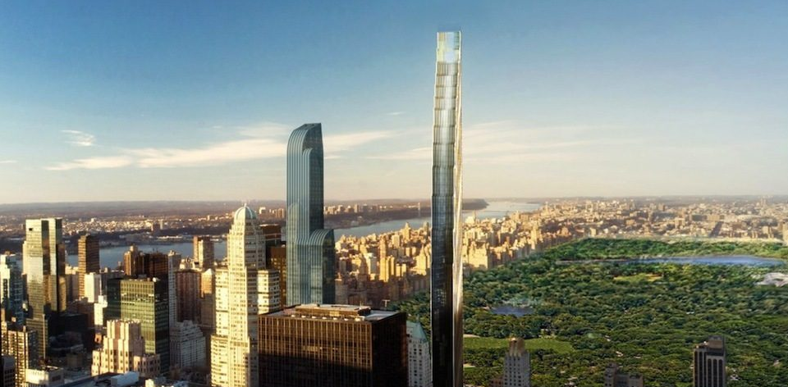
Extreme Engineering – 107 West 57th Street, NY

Slide 22
Extreme Engineering – 107 West 57th Street, NY
Slenderness Ratio
760 ft. (231 m)
231
13
= 17.8
42 ft. (13 m)

Slide 23
Collaboration
Collaboration

Slide 24
Collaboration
Effortless architecture (the architect/engineer partnership is crucial – right from day one)
Experimentation based on detailed study and sound structural principles
Knowledge sharing
Stunning design & presence
Viability

